Slide 1
Name: Debanjan Bhattacharyya
Roll No: 16800116076
Dept: CSE
Subject: Cryptography and Network Security
Sem: 8th
Paper Code: CS801D
Substitution and Transposition Cipher

Slide 2
Substitution Cipher Technique
In Substitution Cipher Technique plain text characters are replaced with other characters, numbers and symbols as well as in substitution Cipher Technique, character’s identity is changed while its position remains unchanged.

Slide 3
Transposition Cipher Technique
Transposition Cipher Technique rearranges the position of the plain text characters. In transposition Cipher Technique, The position of the character is changed but character’s identity is not changed.

Slide 4
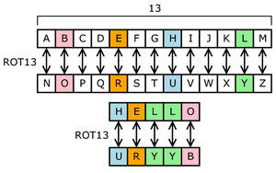
Substitution Cipher Diagram

Slide 5
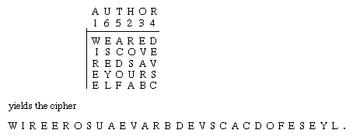
Transposition Cipher Diagram

Slide 6
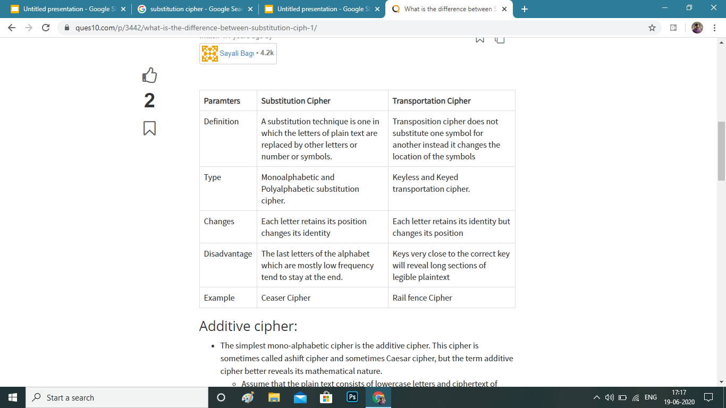

Slide 7
THANK YOU!

